Slide 1

SMART FACTORY
IoT MONITORING SYSTEM
SMART
FACTORY
IoT SYSTEM
Real-Time Industrial Monitoring & Automation using IoT
Brijesh Ahirwar (23095027)
Department of Electronics Engineering
IIT (BHU), Varanasi
assignment_turned_inIoT Internship Project

Slide 2
What I Learned (Part 1)
memory
Arduino-based Embedded Design: Mastered system design using PICSimLab simulation.
settings_input_component
Sensor Integration: Implemented DHT22, LM35, LDR, PIR, and Reed switch modules.
terminal
Firmware Development: Built logic for real-time data acquisition and processing.
swap_calls
MQTT Protocol: Gained hands-on experience with the Publish/Subscribe communication model.
lan
Ethernet Communication: Implemented reliable connectivity using the W5500 module.
cloud_upload
Data Pipeline: Built a complete end-to-end device-to-cloud data transmission flow.
01
Learning Journey

Slide 3
What I Learned (Part 2)
dashboard
Interactive Dashboards
Designed interactive dashboards using ThingsBoard for real-time telemetry and data visualization.
settings_remote
Remote Control & RPC
Implemented Remote Procedure Calls (RPC) for seamless remote device control and management.
02
smart_toy
Rule-Based Automation
Developed complex automation logic, including rule engines for alarms and autonomous control.
analytics
Data Visualization
Mastered real-time visualization techniques using advanced charts and integrated telemetry feeds.
Advanced Concepts
report_problem
Fault Tolerance
Handled critical fault tolerance scenarios and sensor error conditions to ensure system reliability.
cloud_sync
IoT Architecture
Gained a holistic understanding of end-to-end IoT architecture, from physical devices to the cloud.

Slide 4
Introduction to IoT
IoT = network of smart devices. Sensors collect data and send it to the cloud for real-time monitoring and automated decision-making.
03
sensors
Sensor
swap_calls
MQTT
cloud_queue
Cloud
dashboard
Dashboard
Conceptual Framework

Slide 5
Problem Statement
In traditional industrial environments, monitoring of production lines and warehouse conditions is largely manual and fragmented.
🔹 Key Problems
❌ No real-time monitoring
Sensor data is not continuously available
Delays in detecting abnormal conditions
❌ Lack of centralized system
Production and warehouse data are monitored separately
No unified dashboard
❌ Manual control of systems
Devices like ventilation require human intervention
No automation based on conditions
❌ No remote access
Systems cannot be controlled or monitored remotely
❌ No intelligent alarm system
Critical conditions are not escalated automatically
No rule-based alert mechanism
04
The Challenge
👉 There is a need for a smart, automated, and centralized IoT-based system for real-time monitoring, control, and decision-making in industrial environments.

Slide 6



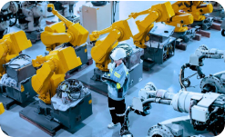
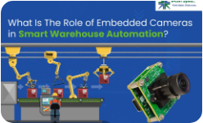
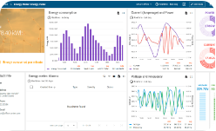
Project Overview
05
System Design
Node 1 — Production Line
Machine monitoring system
Temperature, humidity, vibration
Machine status & relay control
Node 2 — Warehouse
Environment monitoring
Light, motion, door detection
Auto ventilation system
Cloud (ThingsBoard)
Real-time dashboard
Data visualization & charts
Alarm management system

Slide 7

System Architecture
App
Cloud
📡 Perception Layer
Sensors collect real-time data
DHT22 (Temp & Humidity) / LM35
LDR, PIR, and Door sensors
06
Network
MQTT/Ethernet
Data Pipeline
🌐 Network Layer
Data transmitted using MQTT protocol
Ethernet via W5500 module
Publish/Subscribe model for IoT
Perception
Sensors
☁️ Application Layer
ThingsBoard cloud platform
Real-time dashboard visualization
Alarm generation & device control

Slide 8
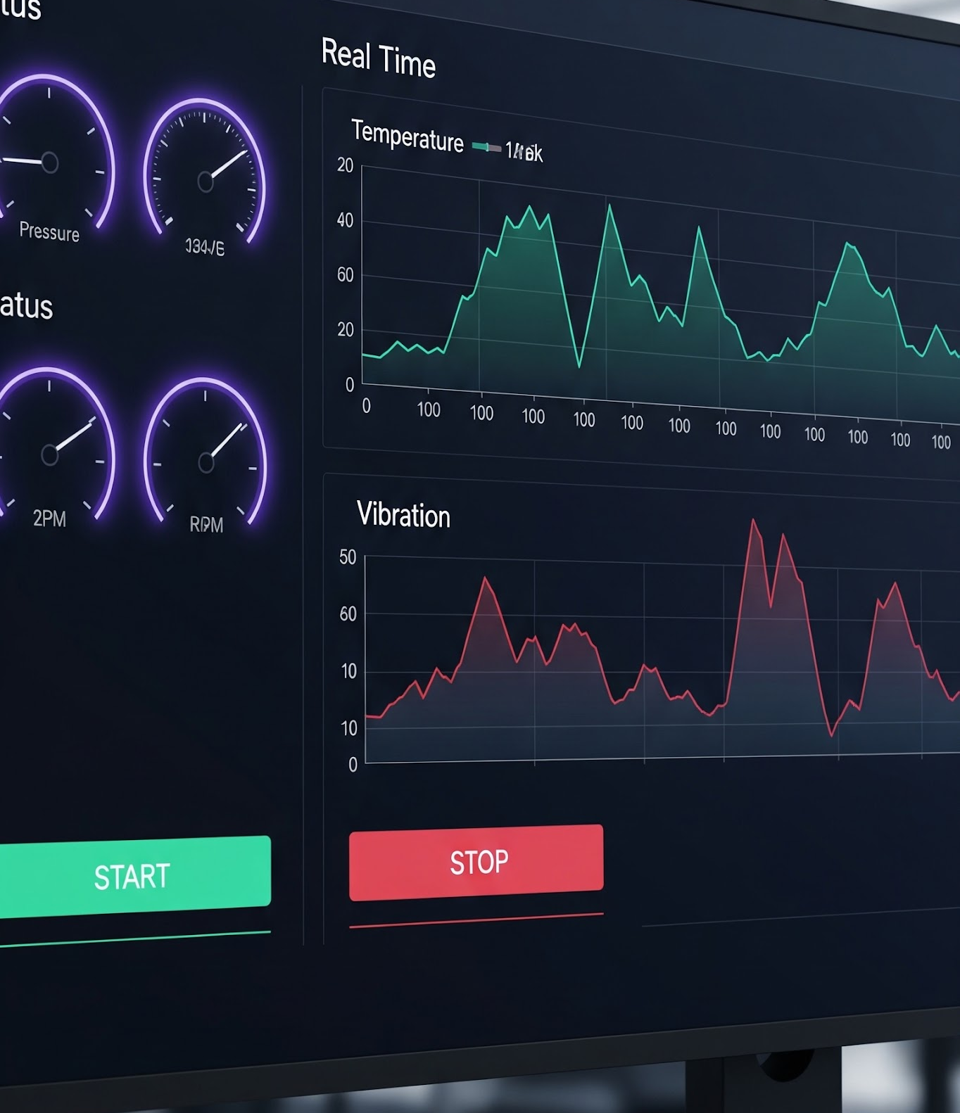
Node 1: Production Line
🟪 Machine Health Monitoring
Sensors: DHT22 (Temperature & Humidity), LM35 (Surface Temperature), Vibration Sensor
Monitoring Parameters: Ambient temperature, humidity, vibration levels, machine status
Local Feedback: LED indicators for machine status and sensor health
Control Mechanism: Relay-based control using RPC for machine ON/OFF

Slide 9

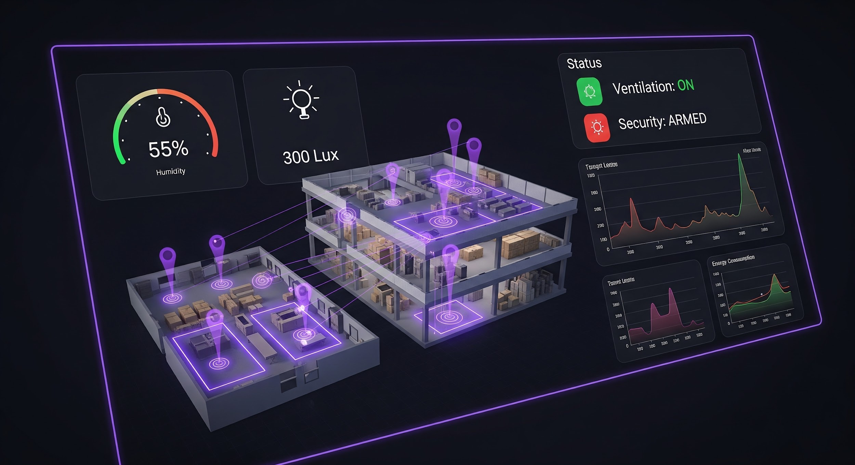
Node 2: Warehouse
🟪 Facility Environment & Security
Sensors: DHT22 (Temp & Humidity), LDR (Light Detection), PIR (Motion Detection), Reed Switch (Door Status)
Monitoring Parameters: Ambient conditions, light levels, motion activity, and access points
Automation Logic: Relay-based ventilation system automatically turns ON when humidity > 85%
Security Features: Intrusion alerts generated via motion detection and door status monitoring

Slide 10
Centralized Monitoring Dashboard
🟪 Key Features
Combined monitoring of Production Line (Node 1) and Warehouse (Node 2)
Real-time visualization of temperature, humidity, and system parameters
Time-series graph for trend analysis
Centralized alarm management system
🟪 System Insight
"Provides a unified interface for monitoring, analysis, and decision-making in real time."
INDUSTRIAL TELEMETRY VIA MQTT

Slide 11
Automation & Features
air
Auto Ventilation
IF humidity ≥ 85%
THEN relay turns ON
Activates ventilation system automatically
notification_important
Safety Alarm
IF temp > 35°C OR vib. high
THEN critical alarm triggered
Displayed on dashboard
settings_remote
Remote RPC Control
Manual override from ThingsBoard
ON/OFF control of relay
Works in real-time
08
Smart Logic

Slide 12
Results & Challenges
check_circleAchievements
Real-time data transmission using MQTT (5 sec interval)
Successful integration of Node 1 and Node 2
Automation logic working (auto ventilation & alarms)
Reliable dashboard visualization on ThingsBoard
Stable system performance with continuous uptime
warningChallenges
MQTT broker latency during high data flow
Sensor calibration variations (DHT22 / LM35)
RPC delay and occasional timeout issues
Dashboard configuration and rule engine setup
09
Evaluation

Slide 13
Thank You!
Thank you for providing this opportunity. This project was highly engaging and provided valuable hands-on experience in IoT system design and implementation.
END
Conclusion
Brijesh Ahirwar
IIT (BHU), Varanasi
Developed a comprehensive IoT solution integrating hardware, network protocols, and cloud computing for industrial intelligence.

